Slide 1
The Evolving WIOA
Welcome
May 17, 2018
Joyce Ottinger
Contract Specialist
Department of Labor
Division of Employment and Training
Notes:
Good morning, thank you for choosing this workshop. I know we are right before lunch

Slide 2
Purpose
The purpose of this presentation is to give an overview of WIOA
Basic Law
Delaware’s participation
Notes:
Feel free to ask questions as we go along. This PowerPoint along with all the other workshops information will be available on-line after the convening for reference.

Slide 3
WIOA
Workforce
Innovation
Opportunity
Act
Notes:
Acronym for the law. Emphasis on Innovation WIOA is transforming how all states handle their workforce

Slide 4
https://www.congress.gov/113/bills/hr803/BILLS-113hr803enr.pdf
Notes:
WIOA became a law July 22, 2014. 298 pages of legalize to review, dissect, and implement.

Slide 5
Federally;
The Departments of Education,
Department of Labor,
Departments of Health and Human Services, Department of Agriculture,
Departments of Housing and Urban Development,
provided leadership in the implementation of WIOA law.
Notes:
These departments had an impact in and are impacted by WIOA They were part of the beginning and continue to work on the implantation across the nation

Slide 6
WIOA Purpose
To amend the Workforce Investment Act (WIA) of 1998 to strengthen the United States workforce development system.
WIOA works for Workers & Job Seekers
WIOA Works for Employers
WIOA works for Communities
WIOA works for Government
WIOA WORKS FOR EVERYONE
Notes:
Including everyone in the United States Workforce Skilled employees and knowledgeable employers improves the communities. WIOA is for everyone

Slide 7
WIOA Improvement Efforts
Workforce Development System
Training
Employment Services
Job Corps
Adult Education
Vocational Rehabilitations Services
Agency Partnerships
More
Notes:
WIOA is designed to impact Title I Adults, Dislocated workers, youth, national programs, Job Corps, and Employment Service Programs. All the Departments involved in writing the law are impacted by WIOA

Slide 8
WIOA Improvement Efforts
Alignment of
Workforce Investment,
Education
Economic Development
Improve the structure and delivery of services
Notes:
WIOA is about aligning, merging, knowing. Improvement of services with agency referrals ensure everything available is given.

Slide 9
WIOA Improvement Efforts
Provide Workforce Development Activities that increase
Credentials
Employment retention
Increased earnings
Notes:
More marketable employees that stay on the job

Slide 10
WIOA Improvement Efforts
Improve the quality and labor market relevance of
Workforce Investment,
Education and
Economic Development efforts
Notes:
Quality and Significance of knowing where the jobs are currently and in the future. Getting state agencies out of their boxes or silos to share information

Slide 11
WIOA Improvement Efforts
Increase
Access & Opportunities
Employment
Education
Training
Supportive Services
For everyone, but especially those with barriers
Notes:
ACCESS and Opportunity Everyone should have the same opportunities.

Slide 12
Requires States to Strategically Align Workforce Development Programs: WIOA ensures that employment and training services provided by the core programs are coordinated and complementary so that job seekers acquire skills and credentials that meet employer needs.
Notes:
Think differently, get agencies out of their “box” or Silos One example, Department of Labor Employment and Training, worked closely with other state agencies in revising to the Request for Proposals for youth and adult training programs.

Slide 13
The WIOA Vision
The WIOA Vision states that the “revitalized workforce system will be characterized by three critical hallmarks of excellence:
The needs of business and workers drive workforce solutions;
One-Stop Centers provide excellent customer service to jobseekers and employers and focus on continuous improvement; and
The workforce system supports strong regional economies and plays an active role in community and workforce development.
Notes:
VISION = Hallmarks of Excellence . This is a change in thinking for most of us. Employers and job seekers are both our customers .

Slide 14
Our State’s Response
Development of a WIOA Leadership Team.
Monthly Meetings
Read, Review, Discuss
Share the points of the Law that the State needed to implement
Teleconferences
Develop more teams across the state
Notes:
This is still occurring. Monthly meetings are held in each county to assist providers with information, referrals, and share strengths. Knowing what is available in your own state, in your own county, in your neighborhood, is an asset and saves on duplication of effort.

Slide 15
DWDB
The DWDB had the task of developing a state plan as to how they were going to implement the WIOA regulations.
The Governor of each state submitted a unified state plan outlining the four year strategy for the State’s workforce development system in early 2016. The WIOA State Plans provide valuable information about the various investment, programs, and initiatives underway to serve our jobseekers, students, and businesses across the country.
Responsible for state workforce development planning and the vision for our system in Delaware.
Focus on unifying the agencies across the state and building relationships and linkages with outside agencies
Notes:
DWDB is the Delaware Workforce Development Board -- William Potter is the Director. The state plan was not something we just submitted, it is something that guided us in making changes. We are being measured on completing what is in the plan.

Slide 16
WIOA Leadership Team
The WIOA Leadership Team is made up of administrators from major partner agencies. It works to guide the implementation of the WIOA Law as it relates to the redesign of the job seeker & employer support services within Delaware’s Workforce Development System.
The WIOA Leadership Team has worked hard to create a positive, open, and creative atmosphere as Delaware takes on the continuing opportunities and challenges of revitalizing and re-organizing the workforce development system.
Notes:
The Leadership Team continues to grow, meet, review and discuss. It does include everyone, and works hard to ensure the agencies are partnering and moving forward.

Slide 17
One-Stop Operator
Key Duties:
Facilitation of Local One-Stop Teams
Coordination of Annual One-Stop Convening
WIOA Leadership Team Member
Notes:
A significate change in how agencies operate is the WIOA Operator. This is Hope Ellsworth, She is instrumental in brining all agencies together. She is involved in every county, and is a main linkage piece of WIOA

Slide 18
One Stop Partners
Department of Labor
Division of Employment and Training
Division of Vocational rehabilitation
Division of Unemployment Insurance
Department of Health and Social Services
Division of the Visually Impaired
Division of Social Services
Division of State Service Centers
Division of Aging Adults with Physical Disabilities
Office of Financial Empowerment
Department of Education
Delaware State Housing Authority
Wilmington Job Corps Center
Criminal Justice Council
Department of State – Division of Libraries
Criminal Justice Council
Division of Small Business, Development & Tourism
https://det.delawareworks.com/one-stop-system/System%20Partners.php
Notes:
The laws intent is to make agency partnerships Robust, Vibrant, Meaningful, and Seamless

Slide 19
Cooperation
Synchronization
Coordination
Teamwork
Knowledge
Communication
Follow Up
Collaboration
Leadership/followership
Together
Harmonization
Notes:
WIOA is all about generating partnerships and teamwork. Seamless services being provided

Slide 20
One Stop Mission
Local One Stop Teams will provide a regularly scheduled forum to further evolve Delaware’s One Stop system
Teams will Develop strategies for continuous improvement:
Better coordination of services,
Review of accomplishments,
Identify and address challenges,
Share best practices
Increase networking
Notes:
Monthly meetings are held in each county to assist providers with information, referrals, and share strengths. Knowing what is available in your own state, in your own county, in your neighborhood, is an asset and saves on duplication of effort.

Slide 21
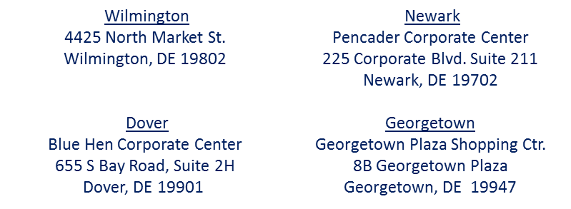
What is the One-Stop System?
There are physical One-Stops which are the Department of Labor locations throughout the state.
There is a virtual One-Stop which is Delaware JobLink where services and resources can be accessed by our consumers and you.
Notes:
One Stop offices provide assistance, job search tips, workshops, computers, fax machines, and are open to the public. Inspiration spaces are available at the libraries to help with job searches.

Slide 22
Delaware’s One Stop System and WIOA

Slide 23
One Stop Mobile Unit
Notes:
This is available via request to any agency for use.

Slide 24
Notes:
This is available at joblink.delaware.gov. Under the Resource tab, you will find, the convening information the Mobile Unit request, the Partners. Tons of information is available under Resources.

Slide 25
Agency Referrals
Sharing information of available programs; what they do; and the resources available are a critical part of the WIOA initiative.
Referrals from one program to another promotes sharing resources and increases the state’s outcomes.
Referrals can be completed through Delaware JobLink or via email at OneStopReferral@state.de.us
Notes:
Referrals helps the job seeker get the assistance they need. Referrals can and should be done for anyone needing something extra. As we learn more about one and share our assistance between job seekers. Referrals are a WIOA measurement, so do refer Use the method that is best for you.

Slide 26
Notes:
Another resource in DJL is the linkage to calendars. If you have a regularly scheduled event, and you want more attendance, let Hope know and she will have it added to the calendar.

Slide 27
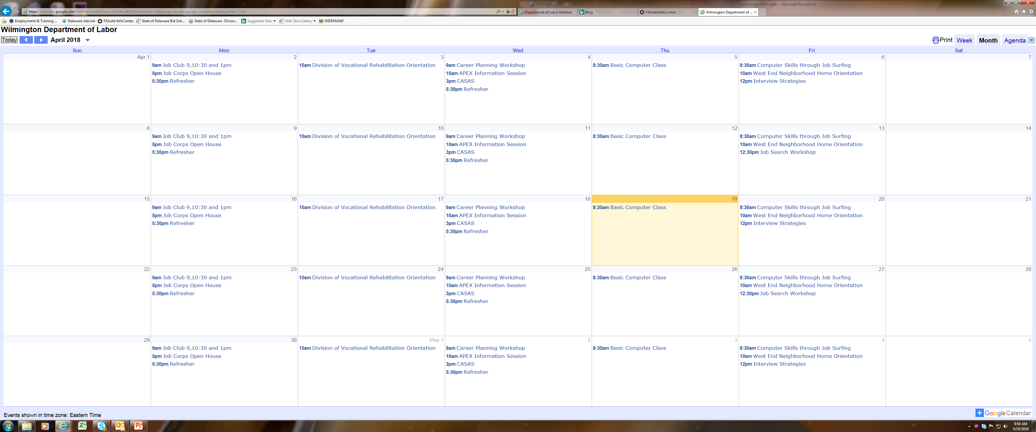
Notes:
Different calendars are available for each county and can be found on Delaware Joblink

Slide 28
More information
The WIOA Final Rules, made public June 30, 2016.
Since 2014, 81 WIOA Related Advisories have been released. These are called TEGLs = Training & Employment Guidance Letter.
https://www.doleta.gov/wioa/
Notes:
If you are like me, you would think Final Rules are Final, but no. More advisories, more guidance, and more changes are being made all the time and will continue to be released as the WIOA evolves, results are reviewed and changes continue to be made

Slide 29
Tools to help
WorkforceGPS is an interactive online communication and learning technical assistance platform. This website, which offers resources and peer-to-peer connection, provided by ETA's national and regional staff to help the public workforce system, education professionals, and business. Website is www.workforcegps.org
Notes:
Workforce GPS is a great resource, and a lot of information and emails. Idea generating website.

Slide 30
Promotes Accountability and Transparency
Core programs are required to report on common performance measures.
Workforce Solutions and local boards are accountable to communities in which they are located.
Workforce system supports strong regional economies and plays an active role in community and workforce development.
Notes:
Common measurements will help everyone work better together. We are accountable to the communities we serve

Slide 31
Performance Targets
1. Unsubsidized employment during 2nd quarter after exit
2. Unsubsidized employment during 4th quarter after exit
3. Median earnings of participants employed 2nd quarter after exit
4. Obtainment a postsecondary credential or high school diploma
Participants attaining a diploma may only be counted if they entered or retain employment within one year after exit OR
Are in an education or training program leading to a post secondary credential within one year after exit
5. Measurable skill gains towards a credential or employment
With focus on serving all undereducated, low-level and underprepared adults
6. Effectiveness in serving employers
7. Sanctions for states that fail to meet performance targets
Notes:
Having all programs measure their success the same way enables better accountability and more uniform results

Slide 32
Evolve
The state is now measuring the 2nd quarter after exit for the first time and assessing where we are, where the gaps are, and developing tools to bridge the gaps and increase the performance.
Communication with the Federal government, the partner agencies and the public being served continues as we review.
Notes:
We are looking at the performance, and really looking to see if the programs are working, and how the data is being captured. Looking for Options, Best Practices and Improvements

Slide 33
Statewide
You will see across the state more conferences, more teamwork, more joining of forces as a direct result of WIOA.
Examples would be:
Libraries linking with job fairs
Training linked with apprenticeships
Notes:
More schools doing job fairs, apprenticeships, partnerships . Can anyone shout out a WIOA partnership?

Slide 34
Goals
WIOA goals are many, but the end results should be:
Reduction in Welfare Dependency
Increase Economic Self-sufficiency
Employees with skills Employers want
Enhances productivity
Notes:
Not just for the State of Delaware, but for the nation

Slide 35
Future
Statewide partnerships continue to grow.
Training programs linked to employment outcomes.
Streamlined common intake procedure for state agencies.
Notes:
WIOA continues to change, to clarify, to resolve, and link agencies and resources. Down the road, there may be one place where you can go to link with all agencies without having to re-apply or submit the same documentations.

